Slide 1
Buffers and Titrations Review
Week of 10/22/18-10/26/18
Geoff Geberth

Slide 2
Important acid and base eqns. and defs.

Slide 3
Buffers
Definition:
A solution that contains substantial amounts of a compound in both its protonated and deprotonated forms that is resistant to pH changes as a result
Perfect/Ideal Buffer:
pKa = desired pH
Contains equal amounts of acid and base
Buffer capacity:
The total amount of acid or base that can be added to the buffer before neutralizing all of one of the forms of the compound
For equal volume solutions, more conc = higher capacity
For equal conc., greater volume = higher capacity
2 main ways to make a buffer:
Mix the conjugate pair
Partial neutralization

Slide 4
Which of the following has the greater buffer capacity?
50 mL mixture that is .2 M NH₄Br and .3 M NH₃
50 mL mixture that is .5 M NH₄Br and .6 M NH₃
There is more “stuff” to react away, thus it can resist the change for longer.
Remember: if the volumes are the same, the higher concentration will have the higher capacity
Capacity measures how well it can resist a change

Slide 5
Making buffers
Mix the conjugate pairs
Get HA and the salt NaA
Get B and the salt BHCl
Partial neutralization of HA or B (what’s usually done in a lab)
Use the stock to make its own conjugate
Add strong acid/base in a limiting amount
$HA+OH^{−}→A^{−}+H_{2}O$
$B+HCl→BH^{+}+Cl^{−}$
Treat this like a limiting reaction problem

Slide 6
How a buffer works
There is some mixture of an acid or base and its conjugate
Remember: pH is a measure of the H+ concentration
If we add a strong acid, the added proton is neutralized by the weak base, and is converted to weak acid
If we add a strong base, the weak acid neutralizes the strong base and converts to the weak base
We basically turn strong acids and bases to weak ones, where some quantity is protonated, thus minimizing the change to the overall H+ concentration

Slide 7
Pictures always help
Weak acid
(HA)
Add strong base
Weak acid
(HA)
Add strong acid
Weak acid
(HA)
Conj. Base
(A-)
Conj. Base
(A-)
Conj. Base
(A-)
$$HA⇌H^{+}+A^{−}$$

Slide 8
Henderson-Hasselbalch (H-H) Eqn
Relates concentrations of protonated and deprotonated forms
Predicts the pH of a buffer
$pH=pK_{a}+\log\left(\frac{\left[A^{−}\right]}{\left[HA\right]}\right)$
Also works for bases and Kb:
$pOH=pK_{b}+\log\left(\frac{\left[BH^{+}\right]}{\left[B\right]}\right)$
Which goes in the numerator? Remember: Products over reactants!
$HA+OH^{−}→A^{−}+H_{2}O$
$B+HCl→BH^{+}+Cl^{−}$

Slide 9
H-H Eqn practice
Calculate the pH of a buffer solution that is .45 M in NH₄Cl and .15 M in NH₃ ($K_{b} for {NH}_{3}=1.8∗{10}^{−5})$
Note we don’t care about the volume!
From Kb, we can calculate $K_{a}=5.6∗{10}^{−10} and pK_{a}=9.25$ for NH₃
$pH={pK}_{a}+\log{\frac{\left[base\right]}{\left[acid\right]}}$
$pH=9.25+\log{\frac{\left[.15\right]}{\left[.45\right]}}$
$pH=8.77$

Slide 10
H-H practice (cont)
How would you prepare an NH₄Cl-NH₃ buffer ($K_{b} for {NH}_{3}=1.8∗{10}^{−5})$ with a pH of 9?
$\log{\frac{\left[base\right]}{\left[acid\right]}=pH−pK_{a}}$
$\log{\frac{\left[{NH}_{3}\right]}{\left[{NH}_{4}^{+}\right]}=9−9.25}$
$\frac{\left[{NH}_{3}\right]}{\left[{NH}_{4}^{+}\right]}={10}^{−.25}=.56$
For every 1 mole of NH₄Cl salt, we need .56 moles of NH₃

Slide 11
Titration
Definition: procedure in which a strong acid/base of accurate concentration is added stepwise in small amounts (aliquots) to incrementally neutralize a solution
Performed to either determine K or measure the concentration of an unknown
Other definitions
Analyte- the “unknown” solution for which you would like to know the concentration (the stuff in the beaker)
Titrant- the “known” solution which you are using to determine the unknown (the stuff in the burette)
Indicator- compound that changes the color of the solution used to determine when the pH has undergone changes

Slide 12
Titration (cont.)
Equivalence point- point at which the number of moles of added titrant are equal to the moles of acid or base in the analyte solution
Half equivalence point- point at which exactly half of the original analyte has been neutralized (pH = pKa at this point)
End point- point at which an indicator changes color, signaling the stop of the titration
Dependent on the indicator chosen
Proper selection of indicator matches end point with equivalence point

Slide 13
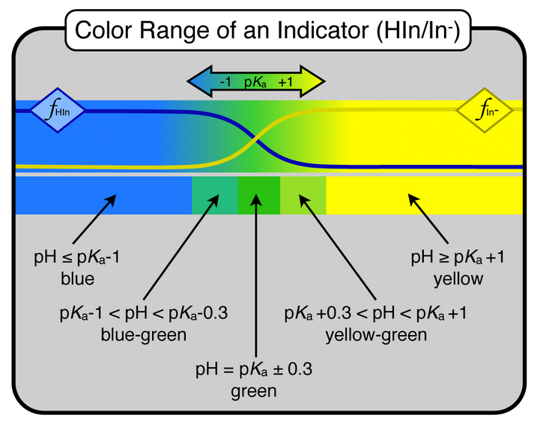
Indicators
Special types of weak acids or bases that have different colors when protonated or deprotonated
Only requires 1-2 drops to be visible
Doesn’t impact pH or overall concentration because quantity is so minute
Approximate range is ±1 off the pKa
Center of range is pH = pKa

Slide 14
Protonated state
If you find a molecule in solution, does it have a particular proton attached, or is the proton free in solution?

Slide 15
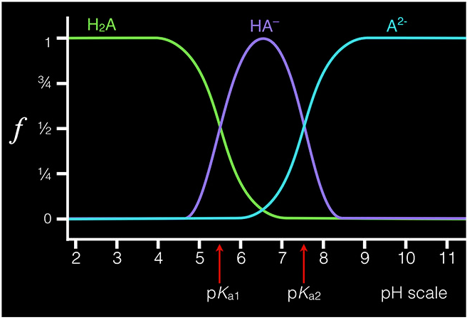
Polyprotic acids
Acids with more than one acidic proton
Each proton has its own equilibrium (multiple Ka’s)
One proton comes off completely before the next
H₃PO₄ is a great example
Fraction of species diagram for diprotic
$f_{A^{2−}}=\frac{\left[A^{2−}\right]}{\left[H_{2}A\right]+\left[HA^{−}\right]+\left[A^{2−}\right]}$
Be able to do this for up to 6 protons

Slide 16
Titration curve for a polyprotic
XS Base
3rd Proton
pH
2nd Proton
1st Proton
mL NaOH

Slide 17
A long titration problem
Consider the titration of 50.0 mL of a .1 M solution of the protonated form of the amino acid analine ($H_{2}A^{+}; K_{a1}=4.6∗{10}^{−3}; K_{a2}=2.0∗{10}^{−10})$ With .1 M NaOH. Calculate the pH after the addition of each of the following volumes of base:
10 mL
25 mL
50 mL
75 mL
100 mL

Slide 18
A long titration problem (10 mL)
Consider the titration of 50.0 mL of a .1 M solution of the protonated form of the amino acid analine ($H_{2}A^{+}; K_{a1}=4.6∗{10}^{−3}; K_{a2}=2.0∗{10}^{−10})$ With .1 M NaOH.
$10 mL ∗ .100\frac{mmol}{mL}=1.00 mmol NaOH added=1 mmol HA produced$
$50 mL∗.100\frac{mmol}{mL}=5.00 mmol H_{2}A^{+}$
$5.00 mmol H_{2}A^{+}−1.00 mmol NaOH=4.00 mmol{ H}_{2}A^{+}$ after neutralizing
$\left[H_{2}A^{+}\right]=\frac{4.00 mmol}{50 mL+10 mL}$
=6.67x10⁻² M
$\left[HA\right]=\frac{1.00 mmol}{50 mL+10 mL}$
=1.67x10⁻² M
$pH={pK}_{a1}+\log{\frac{\left[HA\right]}{\left[H_{2}A^{+}\right]}}$
=1.74

Slide 19
A long titration problem (25 mL)
Consider the titration of 50.0 mL of a .1 M solution of the protonated form of the amino acid analine ($H_{2}A^{+}; K_{a1}=4.6∗{10}^{−3}; K_{a2}=2.0∗{10}^{−10})$ With .1 M NaOH.
This is halfway to the first equivalence point
$$pH={pK}_{a1}=2.34$$
+
0
1-

Slide 20
A long titration problem (50 mL)
Consider the titration of 50.0 mL of a .1 M solution of the protonated form of the amino acid analine ($H_{2}A^{+}; K_{a1}=4.6∗{10}^{−3}; K_{a2}=2.0∗{10}^{−10})$ With .1 M NaOH.
At the first equivalence point we get:
$$pH=\frac{{pK}_{a1}+{pK}_{a2}}{2}$$
$$=6.02$$
This can be derived by looking at the definitions of K, but you haven’t yet discussed this in class

Slide 21
A long titration problem (75 mL)
Consider the titration of 50.0 mL of a .1 M solution of the protonated form of the amino acid analine ($H_{2}A^{+}; K_{a1}=4.6∗{10}^{−3}; K_{a2}=2.0∗{10}^{−10})$ With .1 M NaOH.
This is halfway between the first and second equivalence points
$$pH={pK}_{a2}=9.70$$
+
0
1-

Slide 22
A long titration problem (100 mL)
Consider the titration of 50.0 mL of a .1 M solution of the protonated form of the amino acid analine ($H_{2}A^{+}; K_{a1}=4.6∗{10}^{−3}; K_{a2}=2.0∗{10}^{−10})$ With .1 M NaOH.
At the second equivalence point, only the basic salt, NaA, is in solution
$$K_{b}=\frac{K_{W}}{K_{a2}}=5.0∗{10}^{−5}$$
$$mmol A^{−}=50.0 mL∗0.100\frac{mmol}{mL}=5.00 mmol$$
$$\left[A^{−}\right]=\frac{5.0 mmol}{50.0 mL+100.0 mL}=3.3∗{10}^{−2}M$$

Slide 23
A long titration problem (100 mL)
Consider the titration of 50.0 mL of a .1 M solution of the protonated form of the amino acid analine ($H_{2}A^{+}; K_{a1}=4.6∗{10}^{−3}; K_{a2}=2.0∗{10}^{−10})$ With .1 M NaOH.
$K_{b}=\frac{\left[HA\right]\left[OH^{−}\right]}{\left[A^{−}\right]}$
$K_{b}=\frac{xx}{0.033−x}$
$≈\frac{x^{2}}{0.033}=5.0∗{10}^{−5}$
$→x=\left[OH^{−}\right]=1.3∗{10}^{−3}M$
R | A⁻ (aq) + | H₂O (l) <-> | HA (aq) + | OH⁻ (aq)
I (M) | 0.033 | - | 0 | ~0
C (M) | -x | - | +x | +x
E (M) | 0.033 - x | - | x | x

Slide 24
A long titration problem (100 mL)
Consider the titration of 50.0 mL of a .1 M solution of the protonated form of the amino acid analine ($H_{2}A^{+}; K_{a1}=4.6∗{10}^{−3}; K_{a2}=2.0∗{10}^{−10})$ With .1 M NaOH.
$x=\left[OH^{−}\right]=1.3∗{10}^{−3}M$
$\left[H_{3}O^{+}\right]=\frac{K_{w}}{\left[OH^{−}\right]}$
$=7.7∗{10}^{−12}$
$pH=−\log\left[H_{3}O^{+}\right]=11.11$
R | A⁻ (aq) + | H₂O (l) <-> | HA (aq) + | OH⁻ (aq)
I (M) | 0.033 | - | 0 | ~0
C (M) | -x | - | +x | +x
E (M) | 0.033 - x | - | x | x

